Slide 1

Intro to Pandas
ILLINOIS DATA SCIENCE CLUB

Slide 2
Agenda
Git Introduction
1
Intro to Data Science / Python
2
Intro to Pandas
3
Demo!
4

Slide 3
C:\> Terminal C:\> Basics

Slide 4
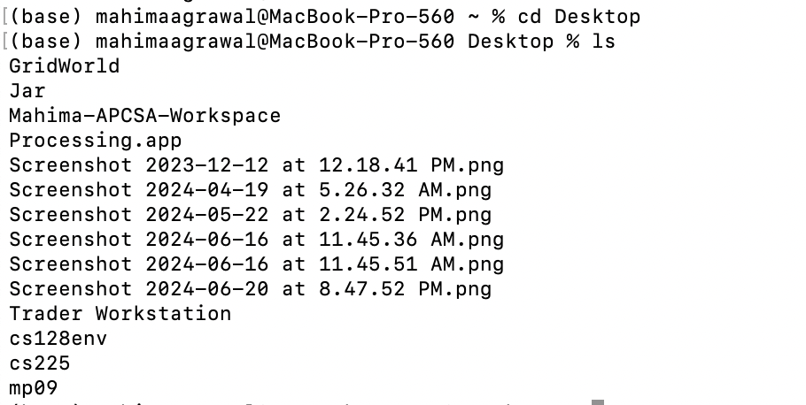
Display Folder Items
ls lists out all of the folders and files that are in a specific folder (dir on Windows)

Slide 5
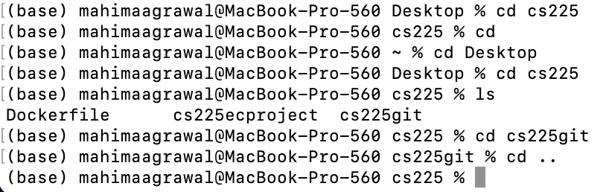
Folder Manipulation
cd <file_name> enters a specific folder in the current directory
cd ../ exits current folder and goes back to previous folder
Notes:
To track a file (record its changes), type in git add

Slide 6
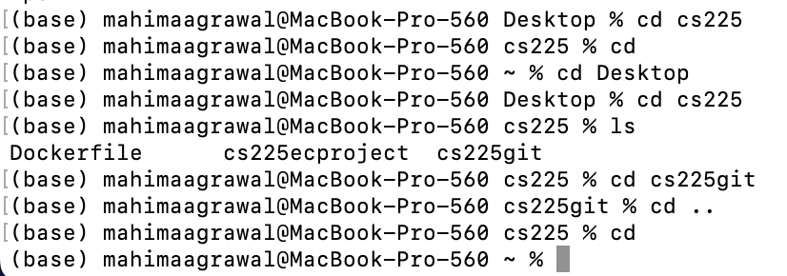
cd exits all folders and goes back to home directory

Slide 7
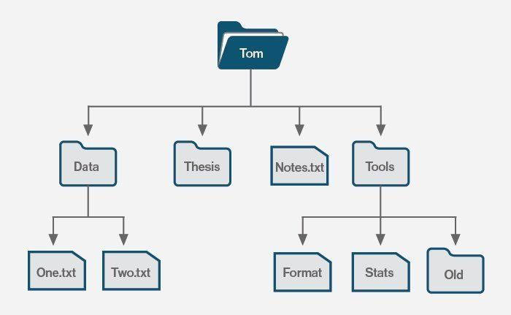
> Data
> Notes.txt
> Thesis
> Tools
dir (Win)
ls (Mac)
Root
cd Tools
cd
cd Format
cd ../../

Slide 8
Git + Github

Slide 9
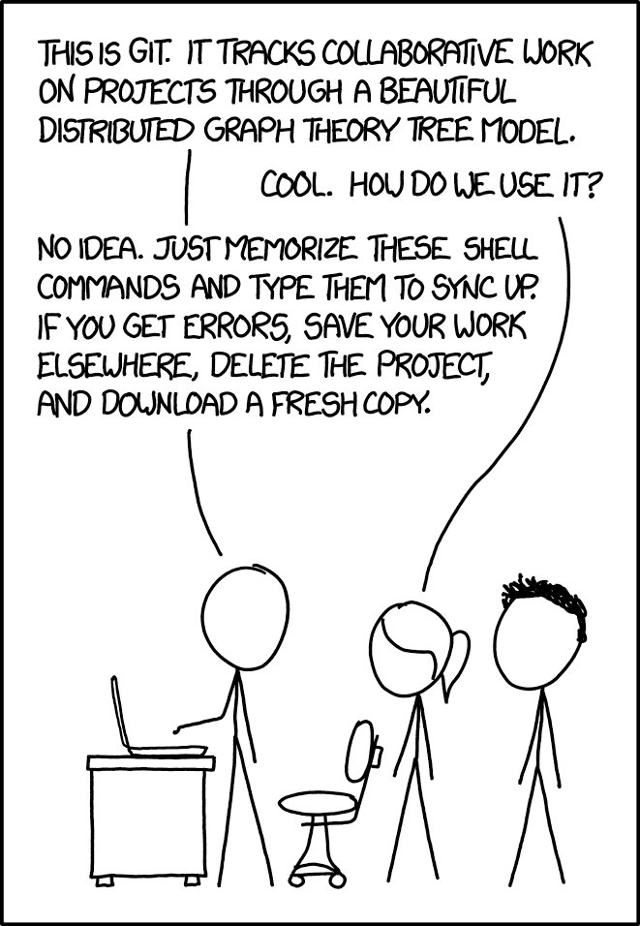
What is Git?
Distributed version control system designed to handle large projects
Key Features
Version Control
Tracks changes in the source code
Allows multiple developers to work on a project simultaneously without overwriting each other's changes
Branching and Merging
Allows developers to create branches to work on features or fixes independently
Staging Area
Has a staging area (or index) where changes can be reviewed and modified before being committed to the repository

Slide 10
What is GitHub?
GitHub is a platform built around Git, a version control system that helps track changes to files and coordinate work on projects among multiple people.
Notes:
GitHub is a platform built around Git, a version control system that helps track changes to files and coordinate work on projects among multiple people.
Version control is crucial for managing changes and maintaining a history of the project.
GitHub allows multiple people to work on a project simultaneously, providing tools for collaborative development.
GitHub is home to millions of open-source projects, fostering a community where developers can share code, contribute to projects, and learn from others.

Slide 11
Configure Git
You only need to configure Git once.
git config --global user.name “...”
git config --global user.email “...”
git config --global init.default branch main

Slide 12
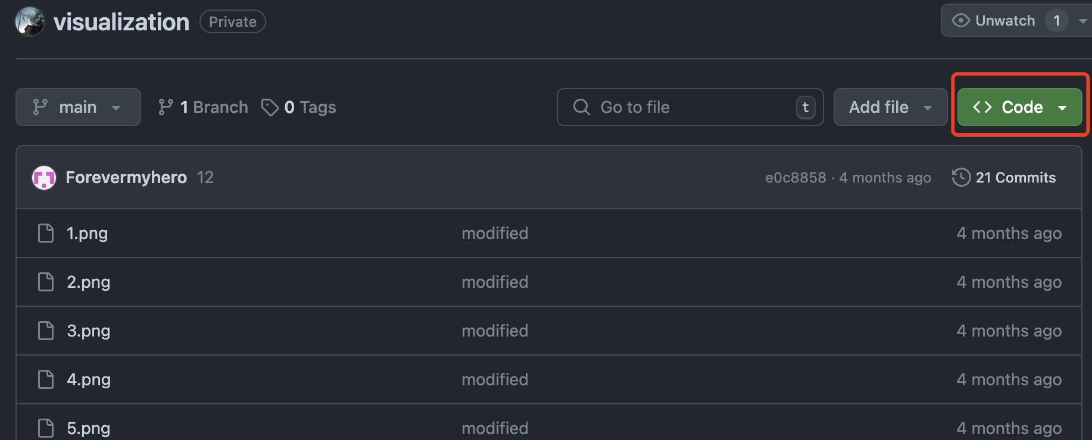
Clone a cloud repo to your computer
1. Navigate to the repo page (make sure you have access to it)
2. Click on the green “code” button.

Slide 13
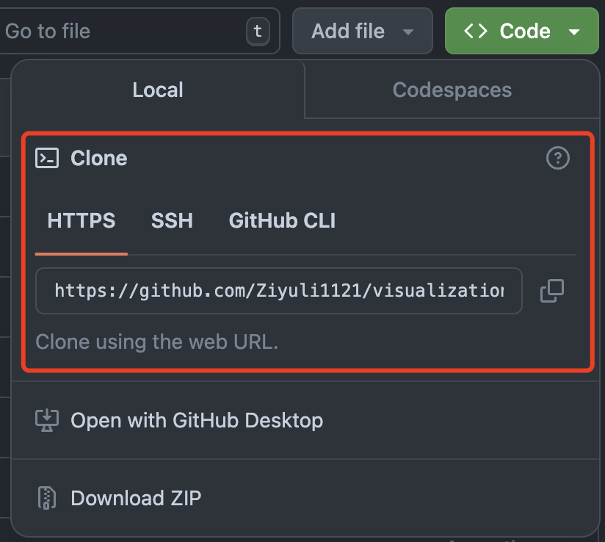
Clone a cloud repo to your computer
3. Navigate to a working directory you like, and then use git clone [URL], using the repository URL.

Slide 14
Track files (git add)
git add ... can specify which file we want to track.
git add -A stages all changes in the repository, including new files, modified files, and deleted files.
Notes:
To track a file (record its changes), type in git add
Q: “A” in white? Stages → saves?

Slide 15
Commit and push changes
To commit, you are taking a snapshot of your repository at THIS point in time (what the files look like right now)
git commit -m “...(message)”
After that, all you need to do is “push” the repository changes
git push
You can also use git status to check the status. This can help you understand the workflow and ensure everything works properly.

Slide 16
Pull and status
Use git pull to download all the history from the remote tracking branches to our local computer.

Slide 17


Recap
git clone
Get a repo from GitHub and clone it onto your machine
Make changes to the repo locally, get some work done
git add
Add any files with changes you want to commit
git commit
Commit the files (with a useful message)
git push
Push the changes, updating the online repo!

Slide 18
Intro to Data Science

Slide 19
What is Data Science?
Data Science: The principles, processes, and techniques for understanding phenomena via the automated analysis of data.
Data Driven Decision Making: Practice of basing decisions on the analysis of data, rather than pure intuition.
What industries can you apply data science to?
Tech
Healthcare
Finance
Agriculture
Sports
Any field that collects and uses data!
Sources: https://www.bryant.edu/graduate/blog/top-industries-data-scientists, BADM 211, for educational purposes only, not for commercial use or sale.
Notes:
Source: BADM 211 course material
Source: https://www.bryant.edu/graduate/blog/top-industries-data-scientists
Source: https://www.google.com/search?q=what+industries+can+you+apply+data+science+to&oq=what+industries+can+you+apply+data+science+to&gs_lcrp=EgZjaHJvbWUyBggAEEUYOTIHCAEQABjvBTIHCAIQABjvBTIKCAMQABiiBBiJBdIBCTEwNTI5ajBqN6gCALACAA&sourceid=chrome&source=chrome.ob&ie=UTF-8

Slide 20
Why Python?
Python: A high-level, general-purpose programming language, can be used for data visualization, machine learning, and statistical analysis.
In iDSC, we use Python for just those reasons:
Versatility: Able to perform many functions outside of data analysis
Readability: Ease of understanding for all levels of programmers
Easy integration: For use with machine learning models
Great for building a model during the data dive!
Source: BADM 211, for educational purposes only, not for commercial use or sale.
Notes:
Source: BADM 211 course material

Slide 21
Pandas Basics

Slide 22
What is a Python package/library?
Python package/library: A collection of objects, methods, and functions that comes with detailed documentation on how to use them. You must import a package/library to use its functions, i.e. “import pandas as pd”
We use aliases like “pd” (short for pandas) to make coding easier.
Useful Python packages include
Pandas: for data analysis and manipulation (alias pd)
Numpy: for large-scale numerical operations (alias np)
Matplotlib: for complex visualizations (alias plt)
Seaborn: for easy data visualization (alias sns)
Source: BADM 211, for educational purposes only, not for commercial use or sale.
Notes:
Source: BADM 211 course material
Pandas is a Python library

Slide 23
Pandas Demo!

Slide 24

9/3 Attendance
Attendance
Instagram: @uiucdsc

